Slide 1
Wine quality
S3641938 Alexander Witedja
S3680881 Fahim Tahmeed

Slide 2
Dataset
From UCI, we chose red wine.
11 continuous values, 1 ordinal value
Checked for out of bounds and missing values, found none
Goal
To determine which attributes can best predict wine quality.

Slide 3
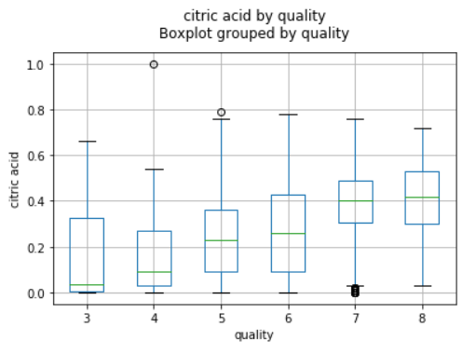
Data visualisation
Explored each column by quality using boxplot
We found 4 attributes that clearly affects quality which are
Alcohol
Sulphates
Volatile acidity
Citric acid

Slide 4
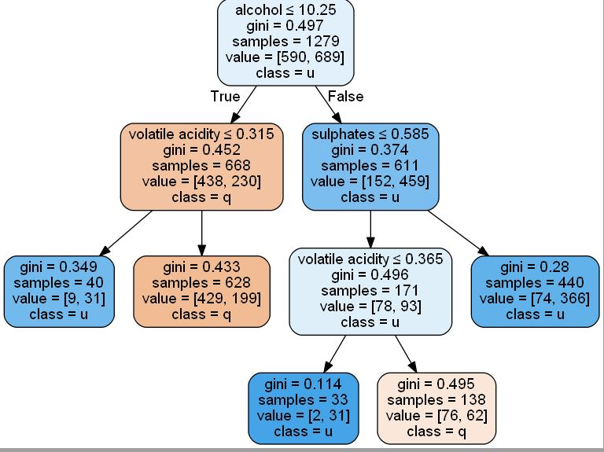
Model and conclusion
KNN micro average is 0.81, test size 0.2. Hill climbing doesn’t include fixed acidity and free sulfur dioxide.
Decision tree micro average 0.73 chose alcohol as defining factor for wine quality:
Conclusion:
KNN has a higher micro average
It selected more features which affects the quality of the wine.

